Slide 1
Build E-commerce website
By: Julian Jones

Slide 2

Project Info
Client is Kanap, a furniture company which sells its products from their physical shop only
The company would now like to add an online store to its physical shop in order to sell its products on the Internet.

Slide 3
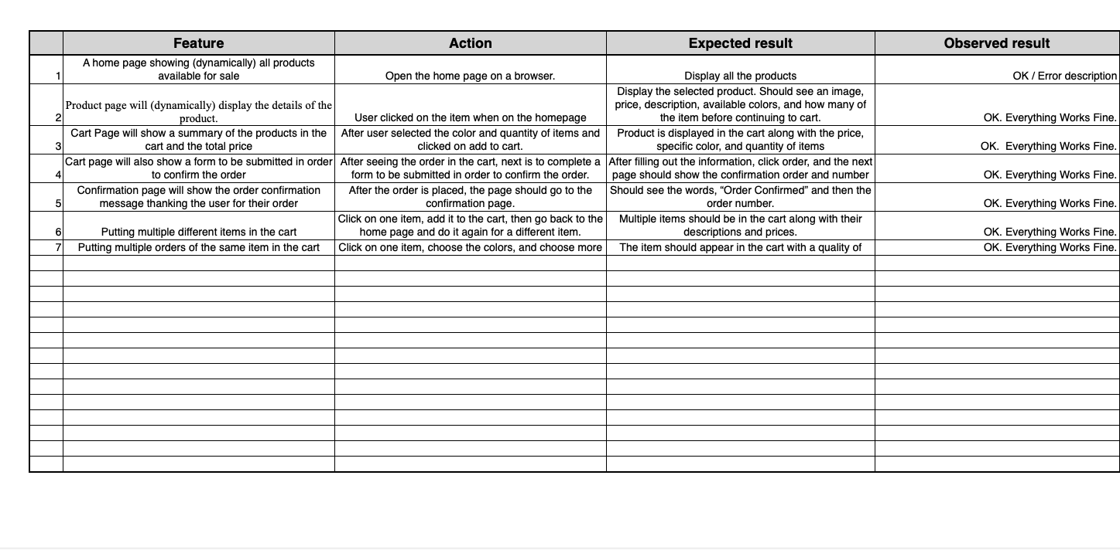
Tasks to Complete
Bring together the work done by the team by integrating the API information into the various web pages using Javascript.
Implement a plan for acceptance tests to make sure the website is functioning correctly.

Slide 4
General Structure
The homepage where all the products will show up ready to be selected
The product page where the selected item will be shown here. Along with price, description, choices of color options, and quantity.
Cart page where details of the order will show here along with the specific information regarding the customer will be shown here via a form.
Last but not least, is the confirmation page which will show up once the order is completed and in the system!

Slide 5
Github link
https://github.com/JulianJ96/Project-5-Web-Dev-Master/tree/master/front/js

